Slide 1

Melanoma Detection with AI and Machine Learning
An Exploration into Advanced Technologies for Skin Cancer Diagnosis

Slide 2
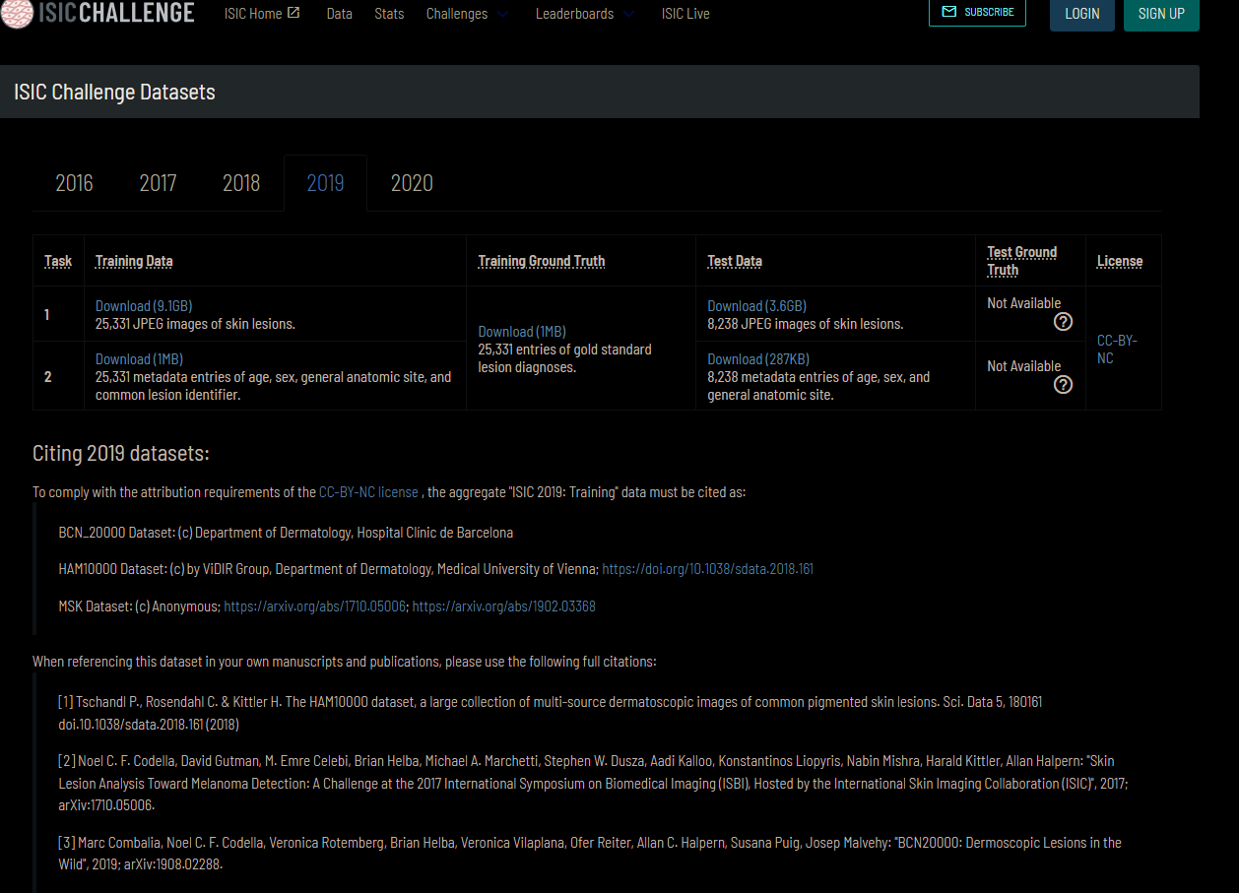

Slide 3
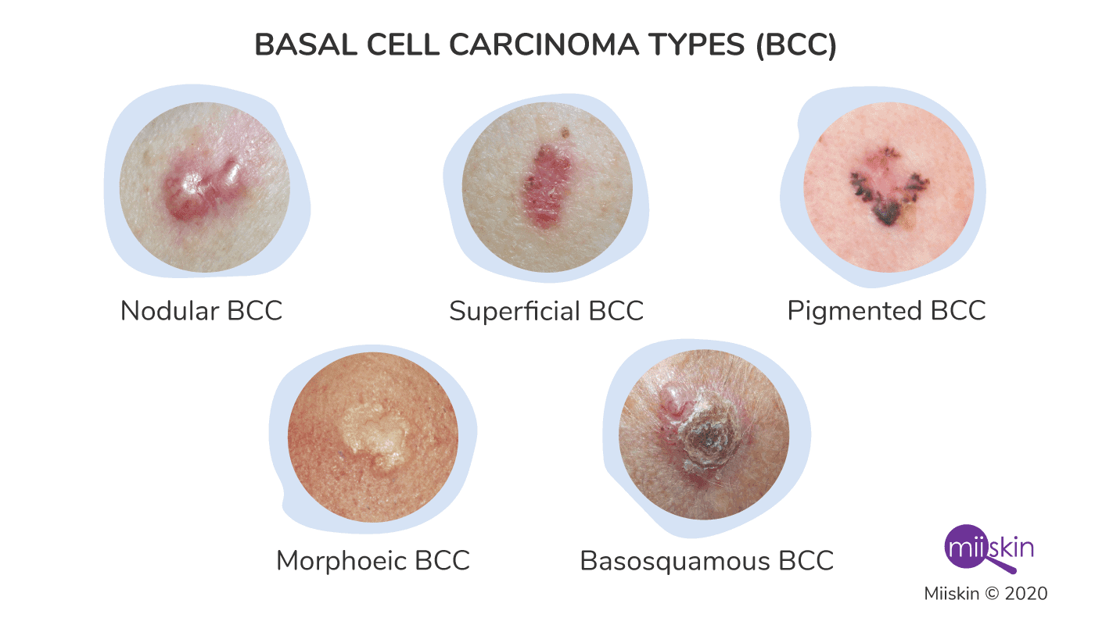
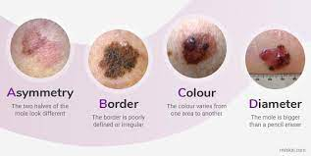
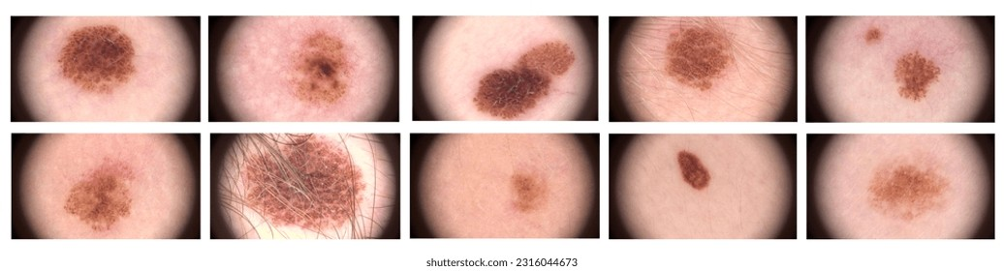
BASAL CELL CARCINOMA
MELANOMA
NEVUS
Basal Cell Carcinoma are found at the bottom of the epidermis.
Basal Cell produces new skin cells as old one dies.
BCC most often occurs when DNA damage from exposure to ultraviolent rays(UV) radiation from the sun or indoor tanning triggers changes in basal cells in the epidermis, resulting in the uncontrolled growth.
BCC’s may ooze, crust, itch or bleed.
Melanoma , the most serious type of skin cancer, develops in the cell that produce melanin.
Melanoma occurs when the pigment –producing cells that give colour to the skin become cancerous.
Symptoms might include a new change in an existing mole.
Melanoma can occur anywhere on the body.
Melanoma accounts for only 1% of the skin cancers but causes a large majority of a skin cancer deaths.
Nevus is basically a mole on skin formed by a cluster of melanocytes.
In most cases, a nevus is not dangerous and doesn’t require treatment. Rarely, they turn into melanoma or other skin cancers. A nevus that changes shape, grows bigger or darkens should be evaluated for removal.

Slide 4
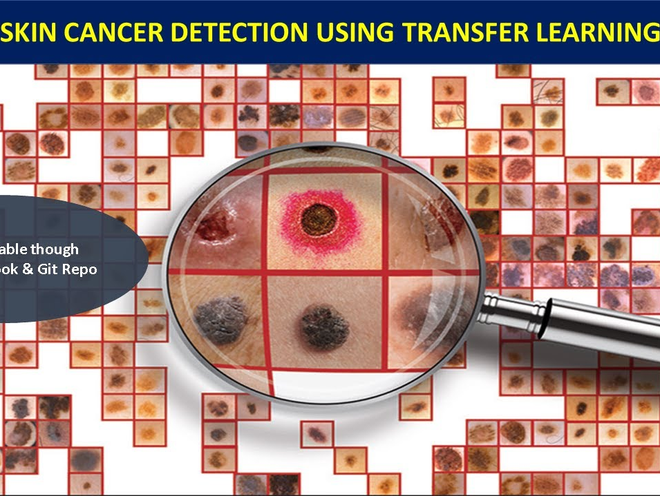
Transfer Learning Deep CNN Approach
Detecting skin cancer using a deep Convolutional Neural Network (CNN) approach with transfer learning is a powerful method that leverages pre-trained models on large datasets and adapts them to the specific task of skin cancer classification. Transfer learning involves using the knowledge gained while solving one problem and applying it to a different but related problem.

Slide 5
Here's a step-by-step guide on how you can approach skin cancer detection using transfer learning with a deep CNN:
Dataset:
Collect a dataset of skin cancer images. Ensure that your dataset has a balanced representation of different types of skin lesions .
Pre-processing:
Pre-process your dataset by resizing images, normalizing pixel values, and augmenting data to increase the diversity of your training set. Data augmentation techniques may include random rotations, flips, zooms, and changes in brightness.
3. Transfer Learning:
Choose a pre-trained CNN model as your base. The idea is to leverage the learned features from a general image dataset to improve the model's performance on your specific task.
4. Model Modification:
Modify the architecture of the pre-trained model to suit your skin cancer detection task. You may need to remove the final layers and replace them with layers suitable for binary or multi-class classification.
5. Fine-tuning:
Freeze the weights of the pre-trained layers and train only the new layers added for your specific task. This helps to retain the knowledge gained from the original dataset while adapting the model to the nuances of skin cancer images.
6. Model Training:
Train your modified model on the skin cancer dataset. Use a suitable loss function (e.g., categorical cross entropy for multi-class classification or binary cross entropy for binary classification) and an optimizer.
7. Evaluation:
Evaluate the performance of your model on a separate validation set. Use metrics such as accuracy, precision, recall, F1-score, and area under the ROC curve (AUC-ROC) to assess its effectiveness.
8. Hyperparameter Tuning:
Fine-tune hyperparameters like learning rate, batch size, and model architecture based on the validation results to improve performance.
9. Testing:
Test your trained model on an independent test set to assess its generalization to new, unseen data.
10. Deployment:
Once satisfied with the model's performance, deploy it for real-world skin cancer detection applications.
https://drive.google.com/drive/folders/1TNHkQiNSqGJZ2-GuJ_5AQdy_fGiDr-Vn

Slide 6
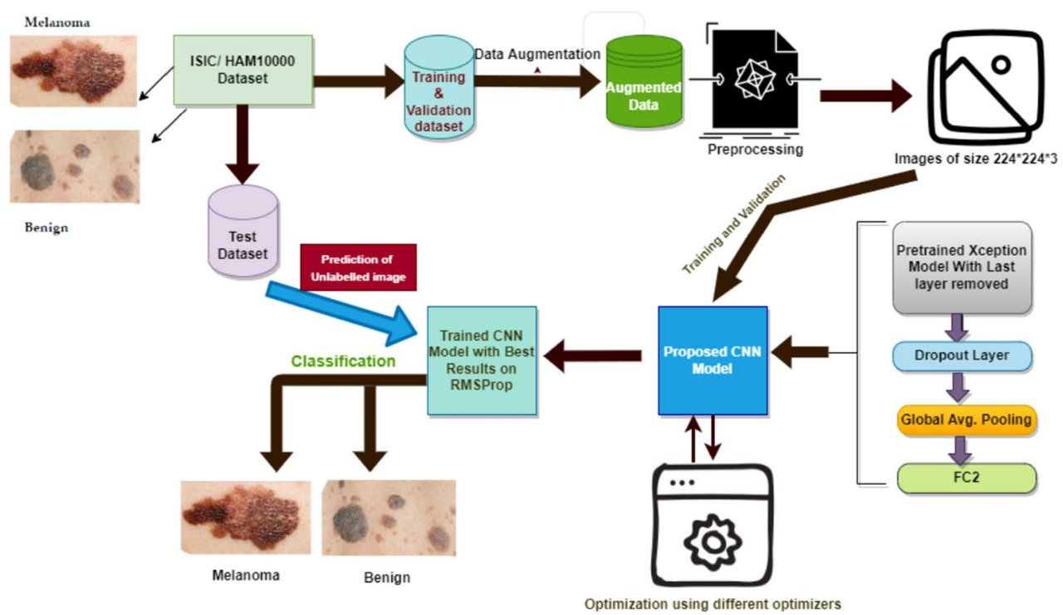
HAM 10000
DATASHEET

Slide 7
Grad Cam Heatmap
Model Architecture:
Assume you have a pre-trained convolutional neural network (CNN) for image classification.
Feature Maps:
During the forward pass through the network, intermediate feature maps are generated at various convolutional layers.
Gradient Calculation:
The gradients of the predicted class with respect to the final convolutional layer are computed. These gradients represent how much the output of the model would change concerning small changes in the pixels of the last convolutional layer.
Global Average Pooling (GAP):
The gradients are then globally averaged across each feature map in the last convolutional layer. This step helps capture the importance of each feature map in relation to the predicted class.
Weighted Sum:
The weighted sum of the feature maps is calculated, where the weights are the global average-pooled gradients obtained in the previous step.
Activation Map:
The resulting weighted sum is applied with a ReLU activation function to obtain the Grad-CAM activation map. This map highlights the regions of the input image that contributed the most to the prediction.
Visualization:
Grad-CAM produces a heatmap overlay on the original image, with brighter regions indicating higher importance in the model's decision.
Grad-CAM (Gradient-weighted Class Activation Mapping) is a technique used for visualizing and interpreting the decisions made by deep neural networks, particularly in the context of image classification tasks. It helps understand which regions of an input image contribute the most to the model's prediction.
https://keras.io/examples/vision/grad_cam/

Slide 8
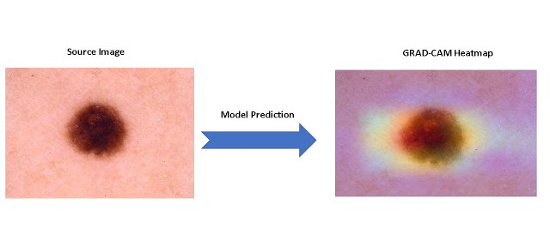

Slide 9


